Slide 1


Hoplites
Hoplite Equipment

Slide 2
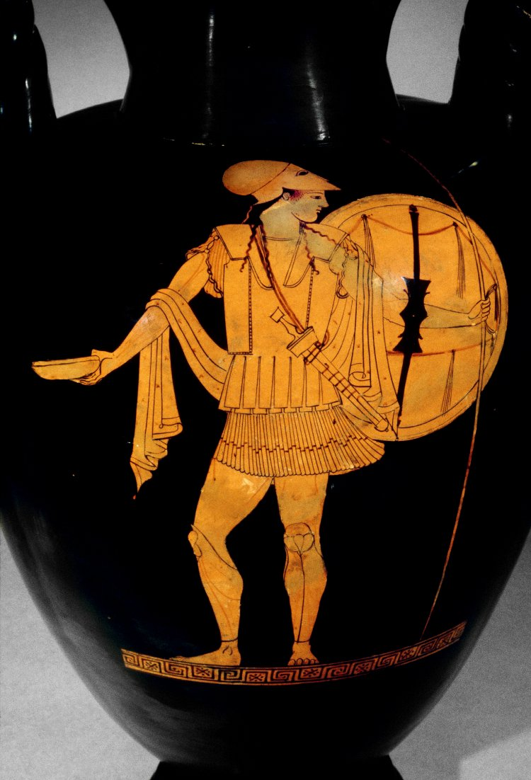
A hoplite was a Greek soldier.
This pot shows a picture of an ancient Greek hoplite.
A hoplite was a soldier.

Slide 3
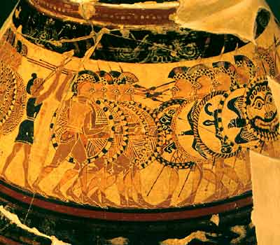

Slide 4
What equipment is this hoplite wearing and carrying?

Slide 5
helmet
tunic
shield
helmet
shield
breastplate or cuirass
breastplate or cuirass
bowl
bowl
sword
cloak
sword
tunic
spear
cloak
tunic
spear
greaves
greaves

Slide 6
What weapons did he use to fight with?

Slide 7
What weapons did he use to fight with?
helmet
tunic
shield
breastplate or cuirass
bowl
sword
sword
cloak
sword
tunic
spear
spear
spear
greaves
This was his offensive equipment.

Slide 8
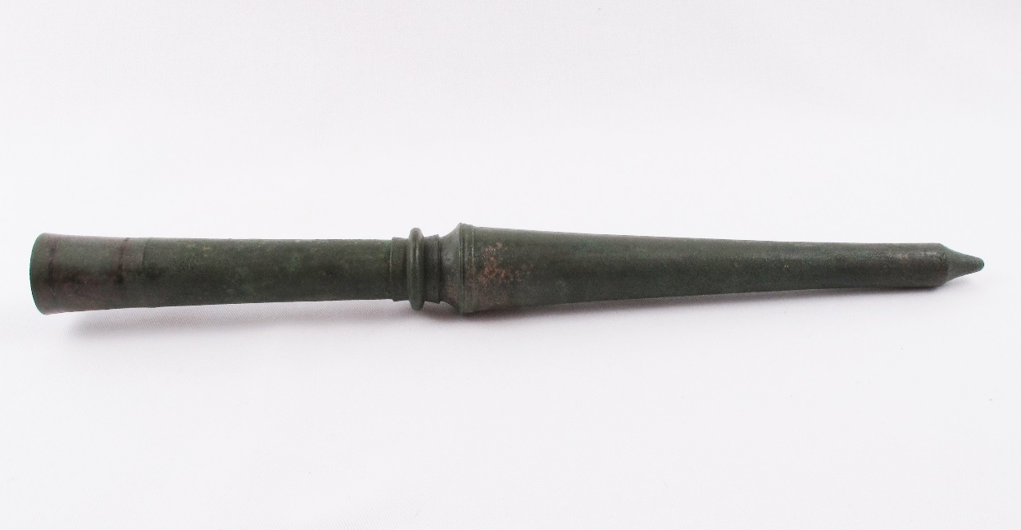

Slide 9
What did he have to protect himself?

Slide 10
What did he have to protect himself?
helmet
helmet
tunic
shield
shield
helmet
breastplate or cuirass
shield
breastplate or cuirass
breastplate or cuirass
bowl
sword
cloak
tunic
spear
greaves
greaves
greaves
This was his defensive equipment.

Slide 11
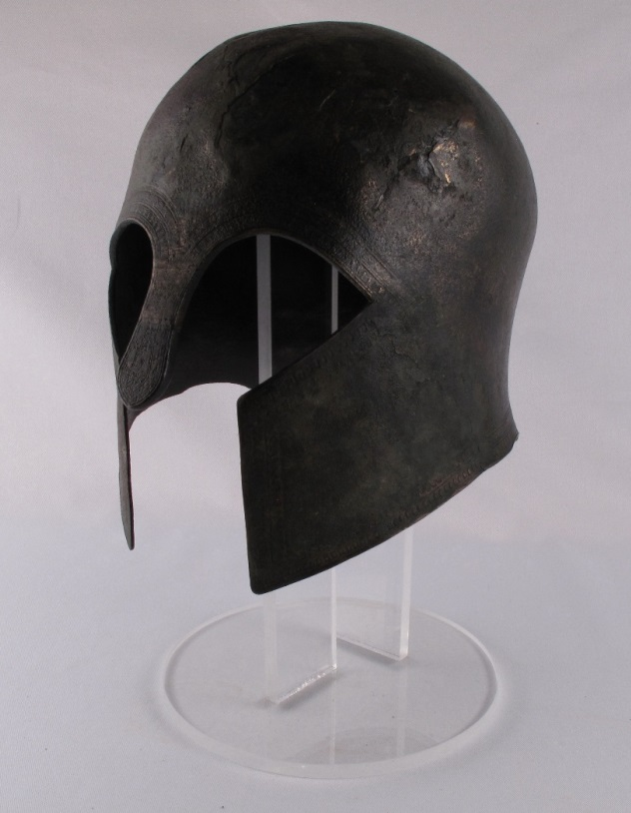
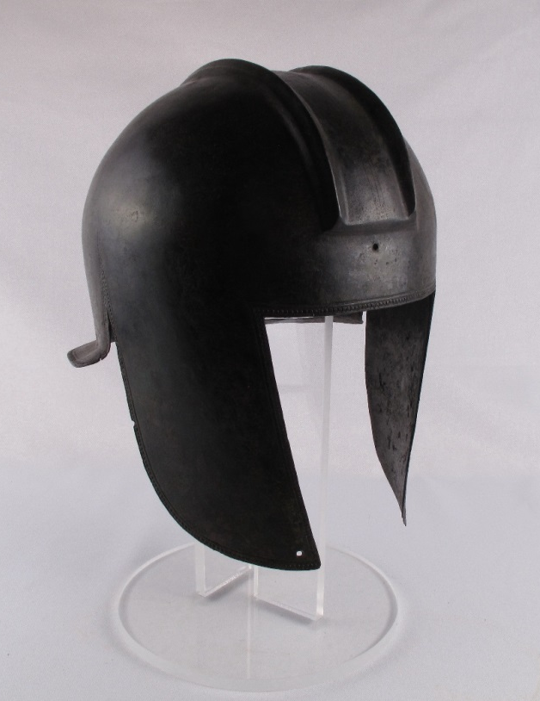
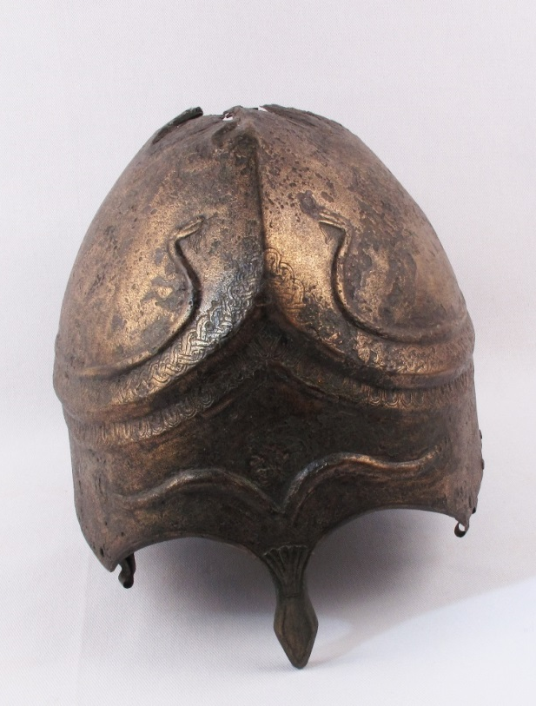

Slide 13
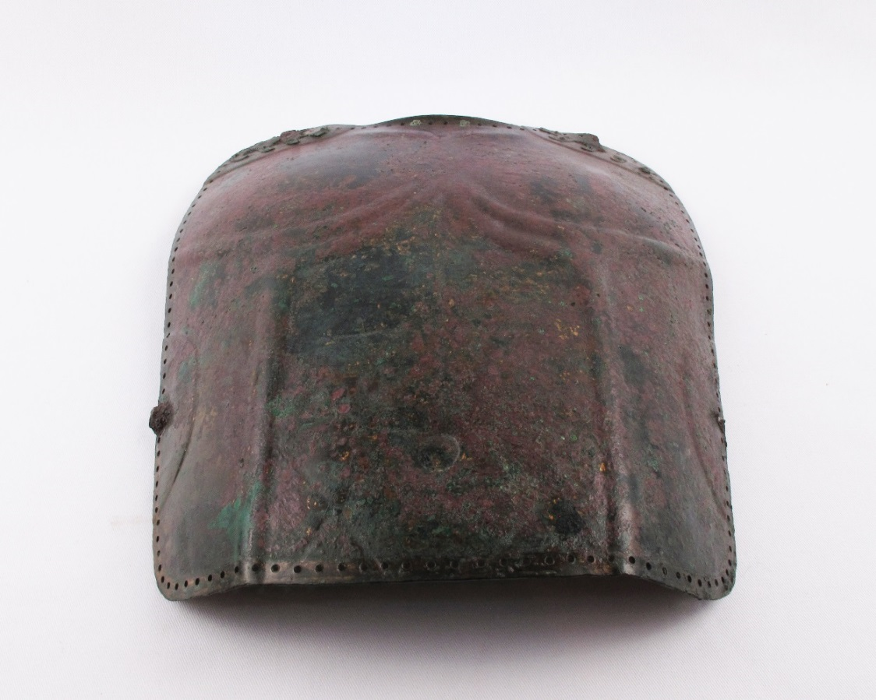
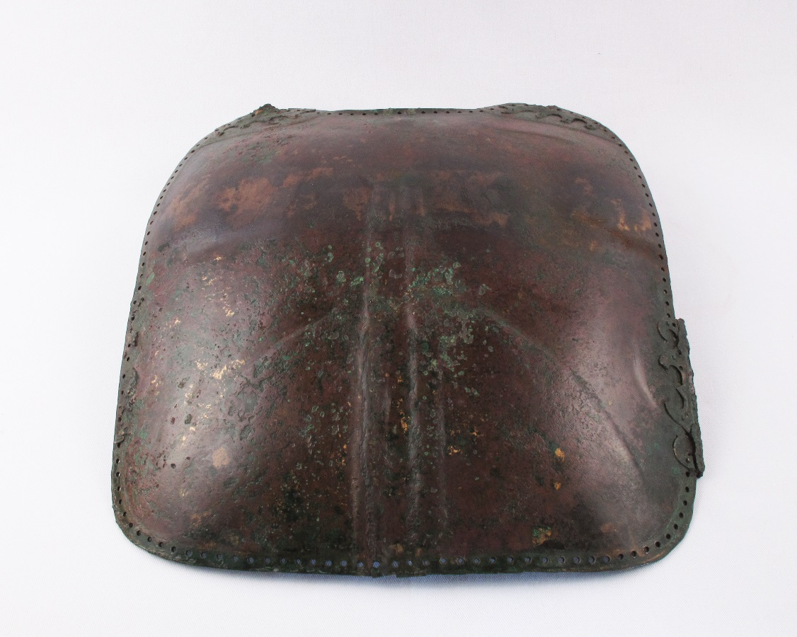
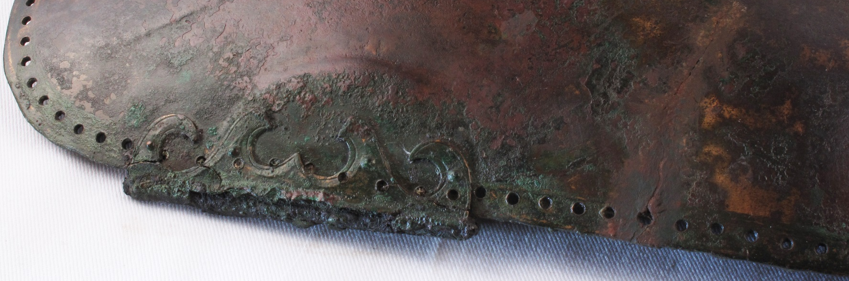

Slide 14
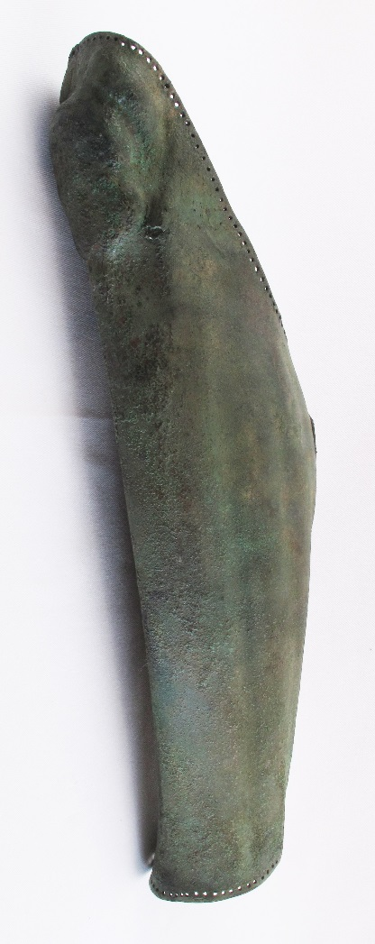

Slide 15
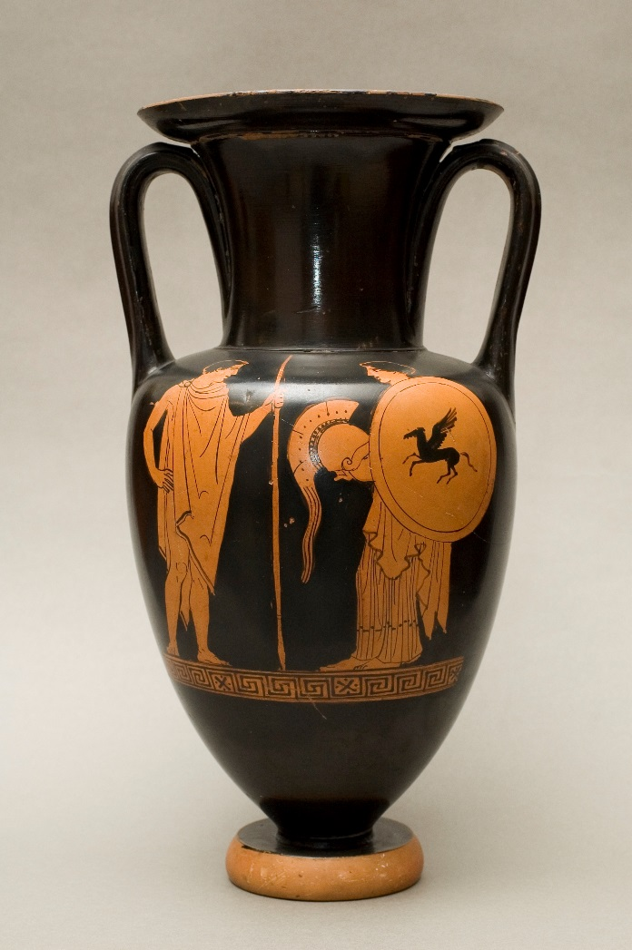
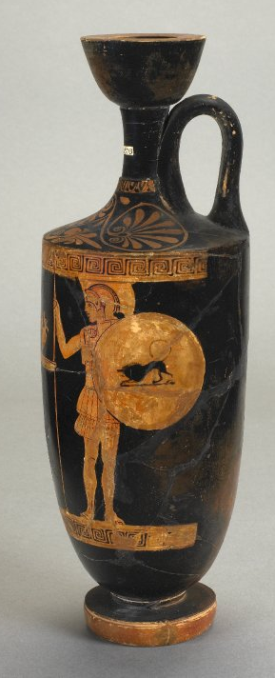
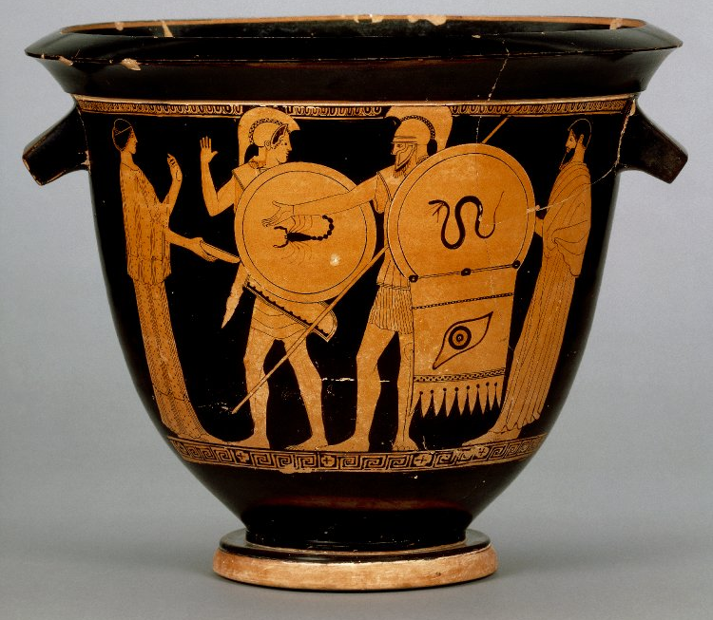
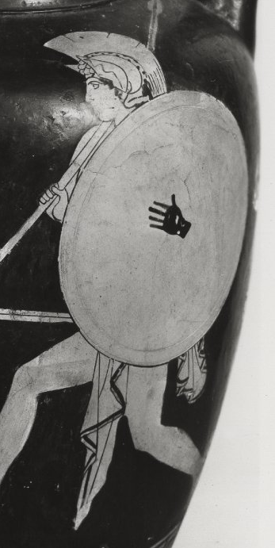
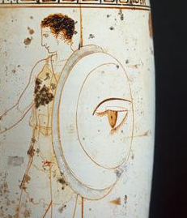
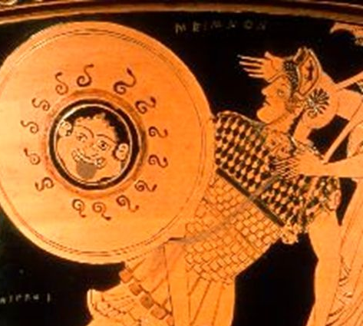
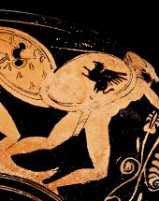

Slide 16
Are there any items in the picture that the hoplite might not take into battle?

